Slide 1
Trident presentation
Mid Somerset CND & Peace group
Index | Slide no |  | Index | Slide no
What is Trident | 3 |  | Arms Industry | 32
Cost of Trident | 6 |  | Opinion polls | 40
Why do we have Trident | 7 |  | Trade Unions | 41
Cameron | 8 |  | Political parties | 48
Govt policies | 9 |  | Jobs v Trident | 56
Who owns Trident | 12 |  | Dangers of having Trident | 67
Another way | 15 |  | Is it a deterrent | 69
Non proliferation treaty | 20 |  | ICAN | 74
Legality | 28

Slide 2
Trident is:
Immoral
Weapon of mass destruction capable of Genocide
Illegal/War Crime
Not an effective deterrent
Not independent
A threat to our security
A waste of money
Costs us jobs
Only benefits the arms industry
Is there a better way ?

Slide 3
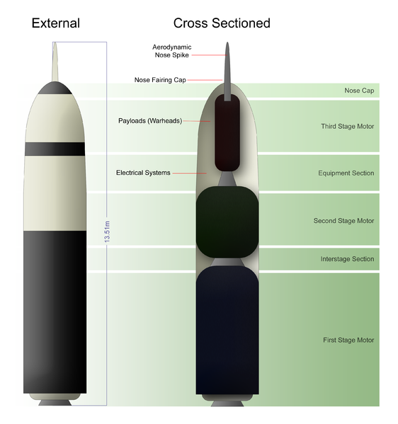
What is Trident
Trident is Britain’s nuclear weapons system.
It is made up of four nuclear submarines.
Each submarine carried up to 8 missiles on board, and each missile carries up to 5 nuclear bombs (warheads) on top.
One Trident submarine patrols the seas at all times
Each of these bombs is around 8 times as destructive as the bomb which flattened Hiroshima in 1945, killing over 140,000 civilians.

Slide 4
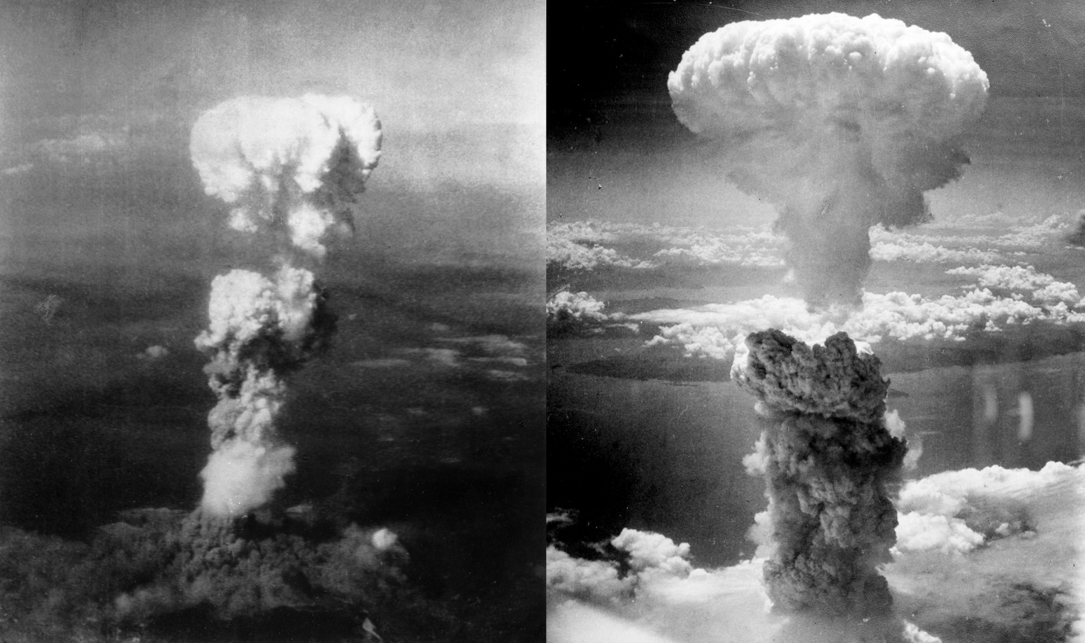
Atomic bombings of Hiroshima and Nagasaki

Slide 5
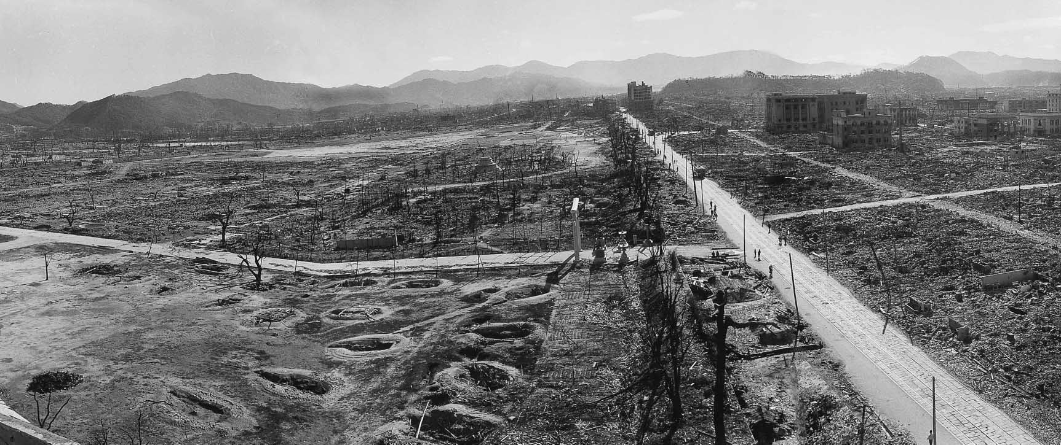
Within the first two to four months of the bombings, the acute effects killed 90,000–166,000 people in Hiroshima and 60,000–80,000 in Nagasaki; roughly half of the deaths in each city occurred on the first day. During the following months, large numbers died from the effect of burns, radiation sickness, and other injuries, compounded by illness. In both cities, most of the dead were civilians
(Exhibition)

Slide 6
Trident has the capacity to kill
320 Million people

Slide 7
War Crimes under the Rome Statute of the International Criminal Court and their sources in International Humanitarian Law
WAR CRIMES UNDER THE ICC STATUTE |  | SOURCE AND PROVISION FOUND IN SOURCES OF IHL
ICC Statute | Art. 8 (2) (a) (committed against protected persons) | GRAVE BREACHES OF THE 1949 GENEVA CONVENTIONS (committed against protected persons) | Source of IHL
Art. 8 (2) (b) (i) | Intentionally directing attacks against the civilian population as such or against individual civilians not taking direct part in hostilities | [When committed wilfully, in violation of the relevant provisions of this Protocol, and causing death or serious injury to body or health] Making the civilian population or individual civilians the object of attack | Art. 85 (3) (a), plus art. 51(2) AP I
Art. 8 (2) (b) (ii) | Intentionally directing attacks against civilian objects, that is, objects which are not military objectives | Civilian objects shall not be the object of attack or of reprisals | Art. 52 (1) AP I

Slide 8
Art. 8 (2) (b) (iv) | Intentionally launching an attack in the knowledge that such attack will cause incidental loss of life or injury to civilians or damage to civilian objects or widespread, long-term and severe damage to the natural environment which would be clearly excessive in relation to the concrete and direct overall military advantage anticipated | [Indiscriminate attacks:] [When committed wilfully, in violation of the relevant provisions of this Protocol, and causing death or serious injury to body or health] Launching an indiscriminate attack affecting the civilian population or civilian objects in the knowledge that such attack will cause excessive loss of life, injury to civilians or damage to civilian objects, as defined in Article 57, paragraph 2 (a) (iii) [of API] | Art. 85 (3) (b) of AP I
 |  | Launching an attack which may be expected to cause incidental loss of life, injury to civilians, damage to civilian objects, or a combination thereof, which would be excessive in relation to the concrete and direct military advantage anticipated, is prohibited [Damage to the natural environment:] It is prohibited to employ methods or means of warfare which are intended, or may be expected, to cause widespread, long-term and severe damage to the natural environment […] and thereby to prejudice the health or survival of the population | Rule 14 of CIHL Study Art. 35 (3) of AP1 Art. 55 (1) of AP1

Slide 9
In 1996, the International Court of Justice concluded that
‘the threat or use of nuclear weapons would generally be contrary to the rules of international law applicable in armed conflict, and in particular the principles and rules of humanitarian law’.
The basis for this judgement is the Geneva Convention. The Geneva Convention Protocol from 1977 states that
‘the civilian population shall not be the object of attack’ and prohibits ‘methods or means of warfare which are intended, or may be expected, to cause widespread, long-term and severe damage to the natural environment’.
Trident and International law

Slide 10
Legality ?
The US-UK Mutual Defence Agreement includes an agreement to exchange classified information to develop their respective nuclear weapon systems . This agreement is renewed every ten years, most recently in 2004.
At the time of the latest agreement, an Early Day Motion was laid down in the House of Commons stating that
the extension of the treaty 'undermines' UK and US commitments to the nuclear Non-Proliferation Treaty, as its signatories are expected not to transfer any nuclear weapons or explosive devices. The government recently confirmed UK and US officials routinely share information on their respective nuclear weapons systems as part of the treaty renewal process.

Slide 11
Replacing Trident would be in violation of the terms of the NPT,
yet the UK government seems determined to pursue this option. £3.9 billion will be spent on the programme even' before a final decision on replacement is taken in 2016.
As well as Trident Britain has a stockpile of 180 nuclear warheads although
the government has announced a reduction in its nuclear arsenal. (There
are nearly 23 thousand in the world, 7500 operational, rest stockpiled).

Slide 12
Is Trident a deterrent?
The following are judged to be the risks by the UK government over the next five years:
Terrorism:
This will remain the most direct and immediate threat to our domestic security and overseas interests. ISIL, Al Qa’ida and affiliates remain committed to attacking UK and Western targets.
Cyber:
The cyber threats to the UK are significant and varied. They include cyber terrorism,fraud and serious and organised crime, espionage, and disruption of CNI as it becomes more networked and dependent on technology, including networks and data held overseas. Cyber risks underpin many of the other risks we face.
International Military Conflict:
The risk is growing. Although it is unlikely that there will be a direct military threat to the UK itself, there is a greater possibility of international military crises drawing in the UK, including through our treaty obligations
National Security Strategy and Strategic Defence and Security Review 2015

Slide 13
In the longer term
Climate change is increasingly a risk to the UK, with the full effects on UK national security more likely to be seen after 2035.
A range of cyber related threats.
Chemical and biological attacks against the UK or its forces.
Proliferation: acquisition of nuclear, chemical and biological weapons, and advanced conventional weapons by state and non-state actors.
Trident doesn’t deter against these risks

Slide 14

Mutually Assured Destruction
Mutual assured destruction, or MAD, is a doctrine of military strategy and national security policy in which a full-scale use of nuclear weapons by two or more opposing sides would cause the complete annihilation of both the attacker and the defender . It is based on the theory of deterrence, which holds that the threat of using strong weapons against the enemy prevents the enemy's use of those same weapons.
Problems with the MAD strategy
Logically all states should aim to obtain nuclear weapons which dramatically would increase the risk of nuclear accident/annihilation. It is untenable to argue for others not to have nuclear weapons if we not only keep ours but insist on upgrading them.
No direct evidence it has ever worked. Other reasons why the cold war never became hot.
  No desire to start World War III following the slaughter of World War II
  Economic power more effective – note the emergence of Germany and Japan
  Nuclear Winter even following limited nuclear exchange

Slide 15
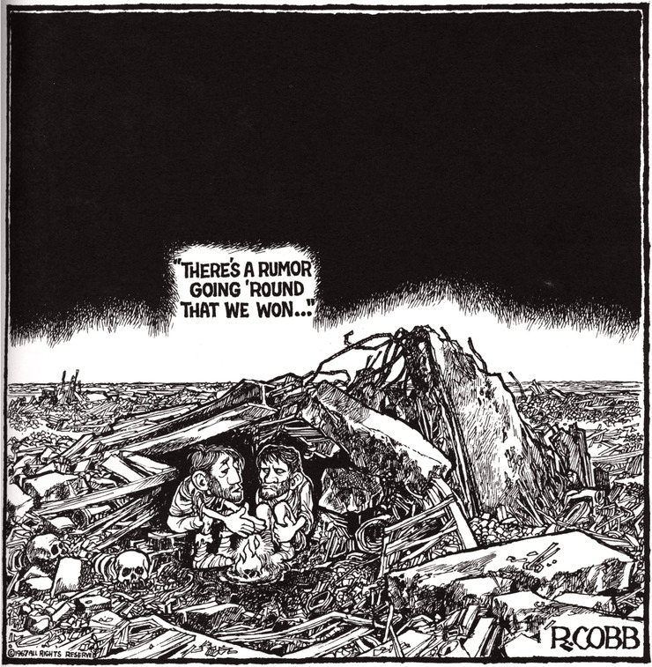
NUCLEAR WINTER
Similar to climate change initially had many critics but the evidence is now overwhelming
Ozone, dust, smoke and humidity in
nuclear winter (1985) Nature 317
Turco, Toon, Ackerman, Pollack and Sagan.
Nuclear Winter revisited with a modern
climate model and current nuclear arsenals :
still catastrophic consequences (2007)
Journal of Geophysical Research
Alan Robock, Luke Oman, and Georgiy L. Stenchikov.
Multi-decadal global cooling and unprecedented ozone loss following a regional nuclear conflict
Michael J. Mills¹, Owen B. Toon², Julia Lee-Taylor¹, and Alan Robock³ (2014),
Earth's Future, 2, doi:10.1002/2013EF000205.
NCAR Earth System Laboratory, Boulder, Colorado, USA,¹
Laboratory for Atmospheric and Space Physics and Department of Atmospheric and Oceanic Sciences, University of Colorado Boulder, Boulder, Colorado, USA,²
Department of Environmental Sciences, Rutgers, State University of New Jersey, New Brunswick, New Jersey, US³

Slide 16
2007 Study
A global average surface cooling of –7 °C to –8 °C persists for years, and after a decade the cooling is still –4 °C (Fig. 2).
Considering that the global average cooling at the depth of the last ice age 18,000 yr ago was about –5 °C, this would be a climate change unprecedented in speed and amplitude in the history of the human race.
The temperature changes are largest over land … Cooling of more than –20 °C occurs over large areas of North America and of more than –30 °C over much of Eurasia, including all agricultural regions.

Slide 17
2014 study
The authors used computational models developed by the US National Center for Atmospheric Research to simulate the climatic effects of a regional nuclear war in which 100 "small" (15 kt) weapons are detonated over cities. They concluded, in part, that
global ozone losses of 20-50% over populated areas, levels unprecedented in human history, would accompany the coldest average surface temperatures in the last 1000 years.
We calculate summer enhancements in UV indices of 30-80% over Mid-Latitudes, suggesting widespread damage to human health, agriculture, and terrestrial and aquatic ecosystems.
Killing frosts would reduce growing seasons by 10-40 days/year for 5 years.
Surface temperatures would be reduced for more than 25 years, due to thermal inertia and albedo effects in the ocean and expanded sea ice.
The combined cooling and enhanced UV would put significant pressures on global food supplies and could trigger a global nuclear famine.
(Albedo is the percentage of incoming radiation reflected off a surface)

Slide 18
MAD Scenarios
Russia or some other foreign power attacks a UK vital interest. We respond with conventional military power but we are overwhelmed.
We have Trident or its equivalent
We don’t have nuclear weapons
We decide to launch a nuclear attack
We decide to not to launch a nuclear attack
Nuclear suicide with likely annihilation of the planet as we know it
We lose the military conflict but humanity survives and we live to fight another day.

Slide 19
Trident was irrelevant to the conflicts in :
    Vietnam
    Falkland war
    Iraq
    Afghanistan
    Iran
    Libya
    Ukraine
    Etc.

Slide 20
The UK government claim that its Trident is independent
Is it under our democratic control?
The UK does not own the Trident 11 D5 missiles it uses; rather they are
leased from the US. The UK government has also recently paid the US £250 million to participate in a missile life extension programme. The missiles are now planned to be in-service until the 2040s.
The British submarines must regularly visit the US base in Kings Bay, Georgia, for the maintenance and replacement of these missiles. The UK pays the US Department of Defence an annual contribution of £12 million towards the overall cost of this base.
The UK warhead is a copy of the US one, with some components directly bought from the US.
Trident is dependent on the larger US system for practical information such as weather and navigational data. The US has the ability to deny British submarines access to its GPS navigation system at any time, meaning the UK would not be able to target a nuclear weapon if this happened .

Slide 21
The UK works closely on the design and maintenance of its nuclear warheads with the three main US nuclear weapons laboratories, (Lawrence Livermore in California and Los Alamos and Sandia in New Mexico.)
Components for British nuclear weapons are transported by air and road between AWE Aldermaston and the US weapons laboratories for ongoing tests.
The UK participates in numerous exchange visits with staff from the US nuclear weapons laboratories. It also participates with the US in "sub-critical" nuclear tests (tests which fall just short of releasing a nuclear explosion).
While the Vanguard-class submarines are made in the UK, at the Barrow-in-Furness shipyard in Cumbria, the design is based on the United States Navy's Ohio Class Trident submarines.
  ....... so technically dependant !

Slide 22
Additionally, Trident is not politically independent.
Trident has been assigned to the US-dominated NATO since the 1960s, meaning Trident could be used against a country attacking another NA TO member state.
Since NATO has not adopted a no-first-use policy, it could also be used pre-emptively against another country that was perceived to be a threat.
It is inconceivable that the UK would use Trident without prior discussion and approval by the US President.
By having such a direct involvement in Britain's nuclear weapons system,
the US exercises significant leverage over the UK's foreign and defence
policy. Trident therefore compromises, rather than asserts, British
independence.

Slide 23
Additionally, Trident is not politically independent.
Trident has been assigned to the US-dominated NATO since the 1960s, meaning Trident could be used against a country attacking another NA TO member state.
Since NATO has not adopted a no-first-use policy, it could also be used pre-emptively against another country that was perceived to be a threat.
It is inconceivable that the UK would use Trident without prior discussion and approval by the US President.
By having such a direct involvement in Britain's nuclear weapons system,
the US exercises significant leverage over the UK's foreign and defence
policy. Trident therefore compromises, rather than asserts, British
independence.

Slide 24
Dangers of keeping nuclear weapons
Going to war by mistake
Chatham House April 2014
Too Close for Comfort
Cases of Near Nuclear Use and Options for Policy

Slide 25
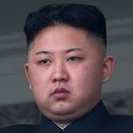
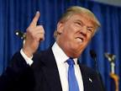
Accident involving nuclear weapons
Broken Arrows: Nuclear Weapons Accidents
http://www.atomicarchive.com/Almanac/Brokenarrows_static.shtml
Since 1950, there have been 32 nuclear weapon accidents, known as "Broken Arrows." A Broken Arrow is defined as an unexpected event involving nuclear weapons that result in the accidental launching, firing, detonating, theft or loss of the weapon. To date, six nuclear weapons have been lost and never recovered.
Makes us a target for nuclear attack
“Madman” gets a finger on the button
Kim Jong-un
Donald Trump

Slide 26
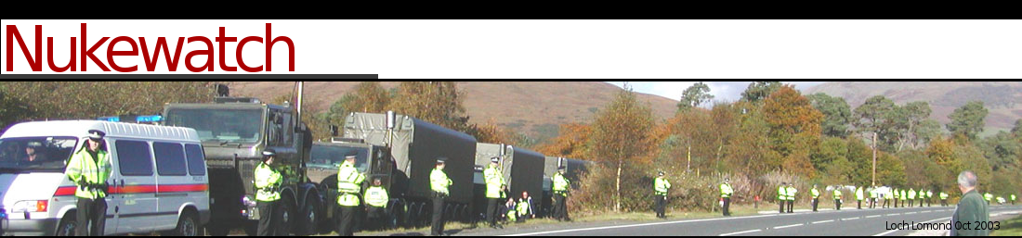
Traffic accident / Terrorist attack ?
Nuclear weapons convoys often pass close to or even through large towns.
The Ministry Of Defence (MOD) says there is little risk of a nuclear detonation during transport, but in an accident the highly volatile “conventional” explosive could be set off, causing the warhead to ‘jet’ plutonium.
More problematic than the explosion would be its effect in dispersing plutonium and uranium particles down wind for miles.
www.nukewatch.org.uk

Slide 27
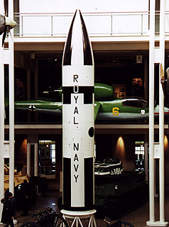
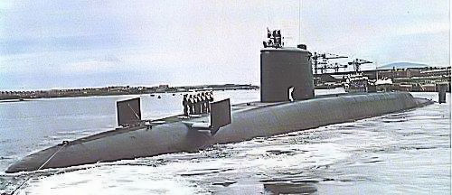
Why do we have Trident?
Are there reasons for not renewing it?
The decision to renew Trident comes before Parliament in 2016.
The Trident system was set up by the Thatcher government in the early 1980s, as a replacement for the Polaris missile system which the UK had since the 1960s.
In the early 1980s, the world was a different place politically. It was still the time of the Cold War, before Glasnost and before the fall of the Berlin Wall (1989-early 1990s).
The current Trident generation will end its working life in the late 2020’s. It takes about 17 years to develop a new system, which is why the government is seeking to make a commitment now. The government has put back the ultimate decision date to 2016, making a delivery date for the first submarine at 2028
The current coalition government is in favour of renewing the Trident system, and is already making its case leading up to the 2016 vote in Parliament.
A Polaris missile on display at the Imperial War Museum. It was the first submarine-based ballistic missile and represented Britain's independent nuclear deterrent since the 1960s.
Polaris submarine HMS Resolution

Slide 28
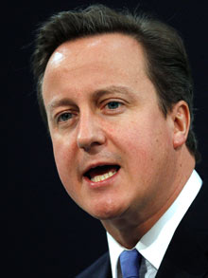
Writing in The Telegraph on 3 April 2013, Prime Minister David Cameron said
“We need our nuclear deterrent as much today as we did when a previous British Government embarked on it over six decades ago.
My judgment is that it would be foolish to leave Britain defenceless against a continuing, and growing, nuclear threat.
To those who say we can not afford a nuclear deterrent, I say that the security of our nation is worth the price.
Only the retention of our independent deterrent makes clear to any adversary that the devastating cost of an attack on the UK or its allies will always be far greater than anything it might hope to gain.”
(full article)

Slide 29
The Government is obliged to fulfil 16 statutory defence policies. Two of these policies relate to nuclear arms.
(PoliciesMinistry of DefenceTrident.docx)
Questions relevant to these policies are:
Do we need Trident?
Is it necessary to fulfil the government’s statutory obligations?
Are these 2 policies contradictory?
Government Policy: Maintaining an effective, independent nuclear deterrent
The protection and defence of the UK is a primary responsibility of the government. The government is committed to maintaining the UK’s national nuclear deterrent, based on a ballistic missile submarine, for as long as the global security situation makes that necessary.
This includes the National Counter Proliferation Strategy 2012-2015
The government launched its new National Counter Proliferation Strategy ahead of the Nuclear Security Summit in Seoul on 26-27 March 2012.

Slide 30
Government Policy: Working towards nuclear disarmament
At present, because of the continued existence of large nuclear arsenals around the world, the possibility of further proliferation of nuclear weapons and the risk of increased international instability and tension, we believe that the UK’s nuclear deterrent remains an important element of our national security. However, we will continue to take steps towards a safer and more stable world where countries with nuclear weapons feel able to relinquish them.
We believe that sustainable nuclear disarmament can only be achieved through a multilateral process. The Nuclear Non-Proliferation Treaty (NPT) provides the basis for global efforts to prevent the spread of nuclear weapons, to promote the safe and secure use of civil nuclear energy and to pursue the goal of a world without nuclear weapons.

Slide 31
There is no explanation for WHY these are the optimum ways for fulfilling these statutory obligations, or what the alternatives might be for fulfilling them.
The argument for providing British jobs is mentioned. British jobs equates to paying the private sector, the ‘military industrial complex.’
And, the decision has been politicised, by postponing it until 2016, after the 2015 general election (replacing trident was a Conservative pledge in the 2010 election) and after the Scottish referendum
Plus, national security has been given as the reason why the Trident review, currently taking place, will not be made entirely public. However, the Conservative version of the review, and their critique of it, will be made fully public.
So, do we need trident? Is there another point of view?

Slide 32
The costs of replacing Trident
Submarine procurement | £26 billion (£20 billion at 2006 prices)
Cost of missile extension programme | £250 million
Replacement warheads from the 2030s onwards | £3 billion
In service costs | £57 billion
Conventional military forces directly assigned to support Trident | £900 million
Decommissioning costs | £13 billion (£9.75 billion at 2006 prices8)
TOTAL | £100 billion
Defence White Paper: The Future of the United Kingdom’s Nuclear Deterrent December 2006
People not Trident : the economic case against Trident replacement

Slide 33
Could the money be better spent?
Jobs not Trident | invest in green spending create 2 million jobs
NHS not Trident | fully fund all A&E services for 40 year employ 150,000 nurses
Homes not Trident | build 1.5 million affordable homes
Education not Trident | end tuition fees build 2,000 primary school,
Climate not Trident | quadruple annual budget for renewable energy
Wellbeing not Trident | fund food banks end fuel poverty insulate 15 million homes
Aid not Trident | provide safe water for all

Slide 34
Trident versus UK jobs
Joint Scottish TUC and Scottish CND publication
the Government’s four year long austerity programme which has squeezed defence budgets and pursued the replacement of Trident at the expense of spending on conventional defence and conventional defence manufacturing jobs In current financial circumstances. It is clear that there will be major employment consequences for Scotland if Trident is not cancelled.

Slide 35
Cuts to conventional forces/weapon systems
In 2012 BAE announced 3,000 job losses at its aircraft plants in Lancashire and York-shire and 600 workers were also laid off from the Agusta Westland helicopter plant in Yeovil.
In 2013 1,700 shipyard jobs were lost at Portsmouth and on the Clyde.
‘Non-protected’ budgets, including Defence, are scheduled for a 30 per cent reduction by 2018-19.
At the same time annual spending on ‘submarine and deterrent’ will increase from approximately £2 billion a year in 2013-14 to £4billion a year by 2023

Slide 36
In February 2014 the National Audit Office expressed concern at the budget projections of the Ministry of Defence to 2023. It queried in particular the sufficiency of its 5 per cent ‘unallocated margin within committed spending of £160 billion to 2023
The number of destroyers and frigates has fallen from 50 in 1990 to just 19 today, and Britain is also temporarily without an aircraft carrier to project airpower to conflict zones
Total troop numbers in the British army have already been cut severely, while the planned rise in reserves has yet to materialize. The UK may face a situation in which it has highly advanced equipment but lacks either the trained forces or the ammunition, maintenance, logistics and other supporting infrastructure to use it effectively.
The Royal Institute of International Affairs Chatham House

Slide 37
Case studies from the United States which show that with early planning, adequate resources, workforce involvement and the political will, local communities can prosper after the closure of large military installations

Slide 38
A detailed breakdown of the skills involved in Trident-related work shows that many of these skills could be transferred to other non-Trident submarine, surface warship work or alternative economic development

Slide 41
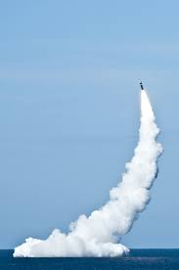


The case for a Scottish Defence Diversification Agency
which is adequately staffed and resourced to engage with trade union representatives to develop and implement realistic plans for defence diversification that have the confidence of the workforce.

Slide 42
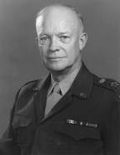
Who gains if we renew Trident ?
Military – Industrial Complex
On January 17, 1961, in this farewell address, President Dwight Eisenhower
warned against the establishment of a "military-industrial complex.
“an immense military establishment and a large arms industry is new in the American experience. The total influence -- economic, political, even spiritual -- is felt in every city, every State house, every office of the Federal government……………….…In the councils of government, we must guard against the acquisition of unwarranted influence, whether sought or unsought, by the military industrial complex. The potential for the disastrous rise of misplaced power exists and will persist. ……………………………Only an alert and knowledgeable citizenry can compel the proper meshing of the huge industrial and military machinery of defense with our peaceful methods and goals, so that security and liberty may prosper together. “

Slide 43
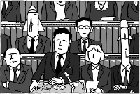
So was Eisenhower right?
Political Influence of Arms Companies
  Ministerial Support for Arms Deals
  The UK government provides a wide range of dedicated services in support of arms deals. They range from assistance to arms companies attending arms exhibitions, through financial support for individual deals, to a significant portion of Defence Attache and embassy time spent promoting UK arms exports.
  The Revolving Door
  The Revolving Door is a well-known and oft-cited concept. Ministers, government officials and members of the armed forces take up jobs in industry, and industry executives take up jobs in, or are seconded to government.
  Advisory Bodies
  In addition to personal contacts there are a plethora of ways that favoured individuals, organisations or companies can feed into government decisions. Seemingly unaccountable committees, task forces, councils, groups and panels exist and interlink to provide the government with the type of information it wants and the veneer of ‘consultation’.

Slide 44
  In addition Arms companies:
  donations and sponsorship
  the use of lobbying companies
  lobbying via constituency MPs
  lobbying via unions
  feed into military strategy/scenario setting and then produce the weaponry to fit the identified need.

Slide 45
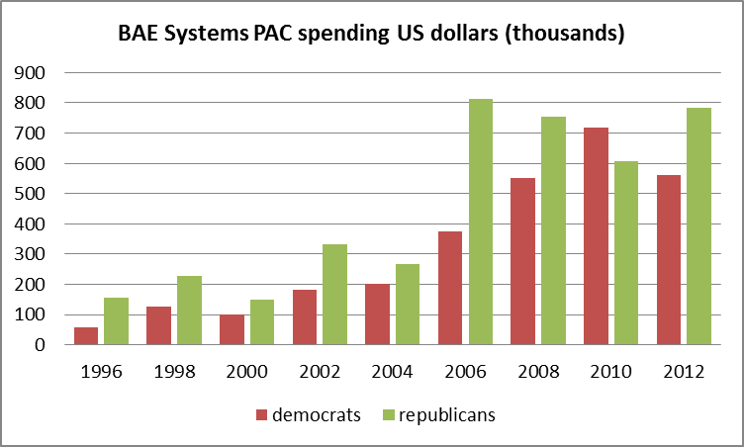
BAE Systems : A Case Study
“We do not make corporate contributions or donations to political parties. Nor do we engage in activity which favours one political party or group over another. In the US, the BAE Systems USA Political Action Committee (PAC) enables employees to make bi-partisan contributions to candidates for Congressional seats and to party organisations that support Congressional races.”
source : opensecrets.org
In 2010, the Department of Justice agreed a plea bargain with BAE. The company was sentenced to pay a $400 million criminal fine, one of the largest criminal fines in the history of DOJ's ongoing effort to combat overseas corruption in international business and enforce U.S. export control laws. www.justice.gov, 1 March 2010

Slide 46
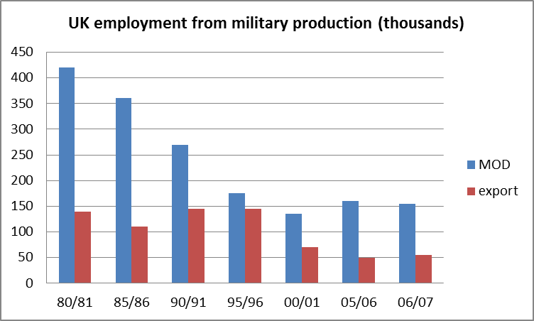
Employment in industries linked to our national defence has fallen significantly 1980-2007.
Arms export jobs now make up 0.2% of the UK workforce and arms exports comprise less than 1.5% of total exports. Arms export jobs are subsidised by at least £9,000 per job per year.
(CAAT June 2009)

Slide 47
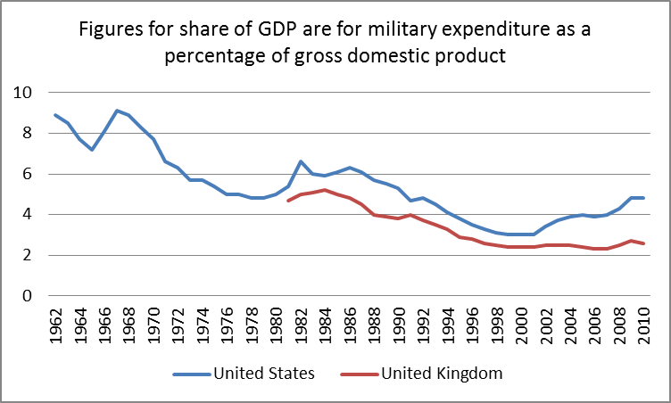
Interesting trends
Source: SIPRI Military Expenditure Database, sipri.org/publications , retrieved 3 March 2014

Slide 48
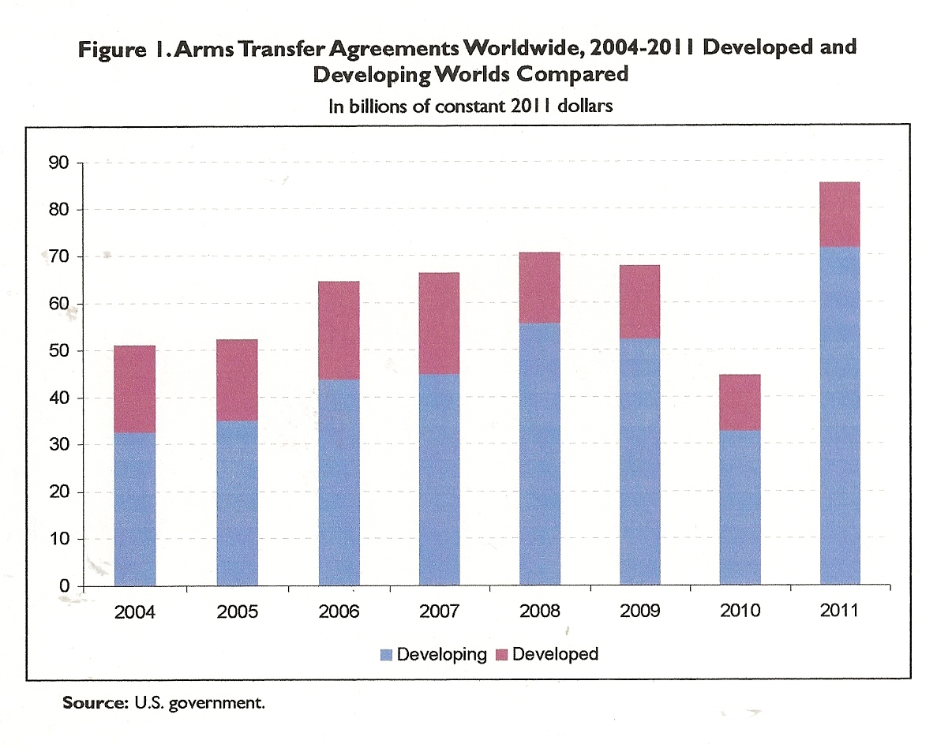
CRS Report for Congress Prepared for Members and Committees of Congress

Slide 49
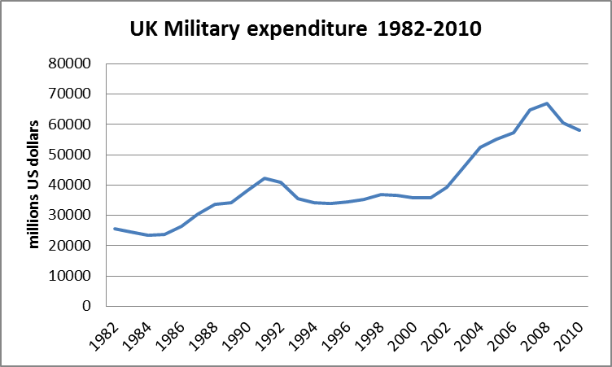
Trident is expected to cost £100 billion over its lifetime. The Royal United Service Institute (RUSI) estimate that by 2021/22 this will represent 30% of the UK Defence Budget.

Slide 50
Is there another way to protect our security?
Omission of the ‘non-replacement’ option – the scrapping of Trident and the cancelling of its replacement – from both the Strategic Defence and Security Review (2010) and the Trident Alternatives Review (2013) is an ‘abdication of responsibility’ by the British Government.
Ban Nuclear Weapons with comprehensive surveillance including inspection by the International Atomic Energy Agency
Invest in conventional weapons (Air, Sea & land)
International Law and Diplomacy

Slide 51
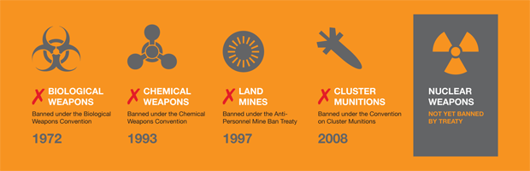
Is it possible?

Slide 52
9 November 1989
Berlin wall comes down
Although the total number of nuclear warheads in the world is decreasing because of US and Russian reductions, all the nations with nuclear weapons continue to modernize or upgrade their nuclear arsenals.

Slide 53
Non Proliferation Treaty
The Nuclear NPT came into force in 1970. Before the treaty was signed 5 states already had nuclear weapons (UK, USA, Russia, China, France). To date 190 states have signed.
Israel, India and Pakistan wouldn't sign and now have nuclear weapons. N.Korea signed but withdrew in 2003.
The Treaty states that
"Each of the parties to the treaty undertakes to pursue negotiations, in good faith, on effective measures relating to cessation of the nuclear arms race at an early date and to nuclear disarmament".

Slide 54
Non-Proliferation Articles I-III
Peaceful use of nuclear energy Article IV-V
Disarmament Article VI
Nuclear weapon free zones Article VII
Amendment and updating Article VIII-XI
Agreement was initially for just 25 years but at the May/June 1995 NPT Review Conference– it was agreed that the Treaty will continue in force indefinitely.
The treaty is discussed and renewed every 5 years . In 2010 the conference conclusions included the following commitments for the treaty's signatories (ie including Britain):
-Reaffirms the unequivocal undertaking of the nuclear-weapon states to accomplish the total elimination of their nuclear arsenals
-Calls on all nuclear-weapon States to undertake concrete disarmament efforts
.

Slide 55
A fortnight before the latest NPT conference in Geneva 2014, Prime Minister David Cameron stated that
'a world without nuclear weapons is a fine ideal' but 'a credible and continuous independent nuclear deterrent remains a crucial component of our national security. That is why I am determined that we will maintain and renew it for generations to come.'

Slide 56
The non-signatories – the other nuclear weapons states
Israel
Israel does not admit to its nuclear capability. What we know about it, we know due to the 1986 leak by Mordechai Vanunu. Israel evidently began testing in 1958, it may have 100-200 warheads.
India
India is open about possessing a nuclear capability. It detonated its first device in 1974, and a second one in 1998. It possibly has 150 warheads.
Pakistan
Pakistan is open about its nuclear capability. It tested a device in 1998, following India’s test of that year. It’s thought to have 120 warheads.
North Korea
In February, 2005, Korea declared that it had nuclear weapons, and in early 2016 allegedly tested a hydrogen bomb. North Korea initially signed the NPT in December, 1985, and withdrew in January 2003.

Slide 57
The unilateral disarmament states
Sweden
In 1946, Sweden started a well-funded nuclear weapons programme. It did not get to the point of testing a weapon, before it ended the programme in 1968. Sweden perceived it was more secure without nuclear weapons. It signed the NPT, and is called a ‘White Knight’ state for its stand on disarmament.
South Africa
In 1993, President F W De Klerk announced to Parliament that South Africa had developed a nuclear weapons system, and that this would now be ceased and dismantled. That year, South Africa signed the NPT, and submitted to inspection by the IAEA.

Slide 58
Nuclear Weapon free zones
Region | Land km² | States | Date in force
Antarctica | 14,000,000 |  | 1961
Outer Space |  |  | 1967
Latin America Caribbean | 21,069,501 | 33 | 1969
Seabed |  |  | 1972
South Pacific | 9,008,458 | 13 | 1986
ASEAN | 4,465,501 | 10 | 1997
Mongolia | 1,564,116 | 1 | 2000
Central Asia | 4,003,451 | 5 | 2009
Africa | 30,221,532 | 53 | 2009
All NWFZs combined: | 84,000,000 | 115 | 39% world pop

Slide 59
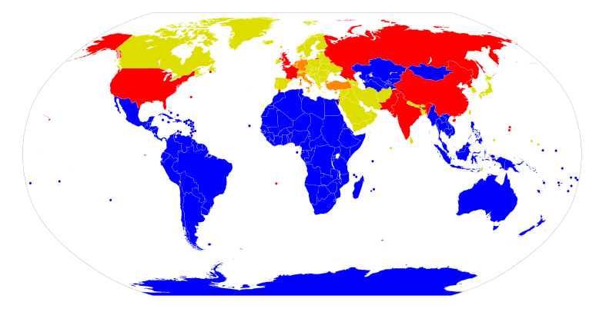
Map of different kinds of nuclear proliferation and nuclear-weapon-free zones as defined by United Nations.
Nuclear-Weapon-Free Zones by international treaty, including territories that belong
to a Nuclear Weapons State that has agreed the territory is subject to a zone.
Nuclear weapons states and territories belonging to them that are not in any NWFZ
Nuclear sharing (US nuclear arsenal stationed there for host country use in wartime
None of the above (but party to the Non Proliferation Treaty(NPT)

Slide 60
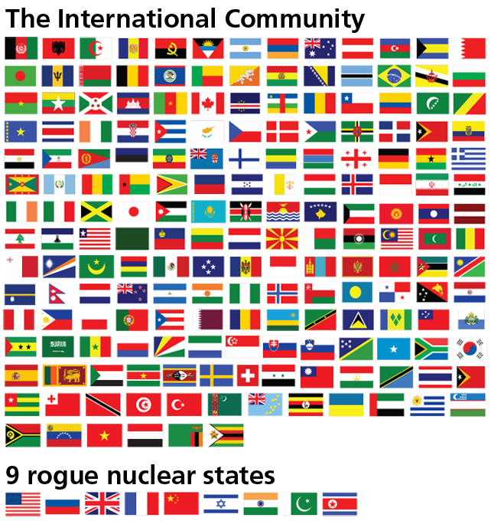

Slide 61
The Real Alternative
What the governments' Trident Alternative Review isn’t telling you
The question of whether or not to replace the Trident nuclear weapon system is of great security and economic importance. Therefore, ahead of the parliamentary vote in 2016, the full range of options must be explored.
The decision must be taken on the basis of what will most contribute to the security of the British people, with a clear understanding of the security challenges of the 21st century.
Omission of the ‘non-replacement’ option – the scrapping of Trident and the cancelling of its replacement – from both the Strategic Defence and Security Review (2010) and the Trident Alternatives Review (2013) is an ‘abdication of responsibility’ by the British Government.

Slide 62
Non-replacement of Trident is a credible option, which offers serious strategic and economic benefits, including:
  improved national security – through budgetary flexibility in the Ministry of Defence and a more effective response to emerging security challenges in the 21st century
  improved global security – through a strengthening of the non-proliferation regime, deterring of nuclear proliferation and de-escalation of international tensions
  vast economic savings – of more than £100 billion over the lifetime of a successor nuclear weapons system, releasing resources for effective security spending, as well as a range of public spending priorities
  adherence to legal obligations including responsibilities as a signatory to the nuclear Non-Proliferation Treaty (NPT)
  moral and diplomatic leadership in global multilateral disarmament initiatives such as a global nuclear abolition treaty and the UN’s proposed Weapons of Mass Destruction Free Zone in the Middle East

Slide 63
What do the British people want ?
63% of the public said they'd back scrapping Trident to reduce the deficit in a BPIX survey for The Mail on Sunday in June 2010.
58% of people say that "given the state of the country's finances, the Government should scrap the Trident nuclear missile system" in an Independent/ComRes poll of September 2009 (Table 7)
54% of the public say Britain should "no longer have any nuclear deterrent" in a Guardian/ICM poll of July 2009 (Table 8)
Only 30% of the public would spend £20bn on Trident when offered alternatives of spending on nurses salaries or affordable homes, in a YouGov poll for The People newspaper from July 2009 (Page 4)
72% of the British public, in a poll in March 2007, did not support the government's plans to replace Trident - More4/Populus poll.
59% of the British public oppose replacing Trident when presented with the cost of £25 billion just to acquire a replacement system. (The equivalent of building around 1,000 new schools at current prices) - ICM poll, July 2006
73% of Scottish people thought it was wrong that £50 billion might be spent on a replacement for Trident. ICM poll, January 2007
64% were against nuclear weapons being based in Scotland for another 50 years. ICM poll, January 2007

Slide 64
The role of trade unions and Trident
Background to trade unions and disarmament
Trade union movement has a long history of supporting disarmament
Many unions affilliated to CND from its foundation to present
Thousands of trade union members are also members of CND favouring the creation of socially productive jobs rather than producing WMD
In 2013 TUC re-affirmed its opposition to Trident replacement

Slide 65
Anti-Trident Position
Public and Commercial Services Union (PCS)
Railway, Maritime and Transport Union (RMT)
Unison
“how can we justify Trident when adult social care is on the point of collapse…wards are closing in every city”
Dave Prentis (General Secretary – Unison)
Mainly draw upon economic arguments against trident

Slide 66
Pro-trident
General Municipal and Boiler-makers Union (GMB)
“The responsible thing to do is not just to renew our nuclear deterrent but build more vessels in Barrow that has the best submarine building capability not just in the UK but in the world”
Billy Coates (GMB Northern Regional Secretary)
http://www.gmb.org.uk/newsroom/vote-on-trident-welcome

Slide 67
Less clear position
Unite (merged from a series of manufacturing and engineering unions and the TGWU – transport and general workers union)
Largest UK trade union
Policy is less clear and open to differing interpretations from both members and political commentators alike. So despite policy stating
“it cannot be right to spend large sums of money on WMD when essential services are cut”
it goes on to say “ we need a policy that would see jobs and skills of unite members preserved and until we receive firm commitments to this we will continue to support our members and their employment”
http://www.unitetheunion.org/campaigning/events/unite-policy-conference-2014/unite-trident-policy/

Slide 68
What to make of all this
Anti-trident unions positions tend to rest on economic arguments, particularly public sector unions who maybe fighting for a living wage for their members in the age of austerity
Pro-trident unions have a large amount of private sector workers in defence jobs, some being in areas of high deprivation – eg Barrow in Furness
However, divisions are apparent between union members and leaders
Important to note that advocates of maintaining Britain’s nuclear arsenal consistently emphasise the likelihood of job losses if this arsenal is to be abandoned.
Is it that “defence jobs” are the concern or “defence contracts” - intimates that private enterprises are at risk of losing their profits

Slide 69
Challenging the myths
Engagement with studies, such as that conducted jointly by the STUC and Scottish CND in 2007, which have played a crucial role in exposing the exaggerated claims of job loss among defence workers
A starting point is to take seriously defence workers’ concerns over their job security and to recognise that Scottish defence jobs have been haemorrhaging over many years
Significantly, these jobs have been reducing over the lifetime of the existing Trident programme. Over that period, 40,000 (35 per cent) of defence jobs have been lost, including 100 at Coulport, when overhaul responsibilities shifted to the US, and 250 at Faslane, principally as a consequence of Babcock privatisation.
The clear message is that Trident and expenditure on nuclear weapons is costing, and will continue to cost, jobs in the defence sector.
http://www.labourcnd.org.uk/2014/04/scottish-defence-diversification-agency/
http://www.stuc.org.uk/news/1155/stuc-launch-new-joint-report-trident

Slide 70
What can be done
Defence diversification is about working with workers in the defence industry to identify how the skills they have and technology they work on can be put to more socially productive use.
Provide a just transition away from the production of weapons of mass destruction to socially productive industries with high-skilled jobs.
Establishment of a Defence Diversification Agency (DDA) which is properly resourced and adequately staffed.
Primary aims of DDA is to comprehensively engage with trade union representatives and other stakeholders in the local and national economies to develop and implement realistic plans for diversification that have the confidence of the workforce.
http://www.morningstaronline.co.uk/a-601b-TUC-Congress-2015-Cancelling-Trident-neednt-cost-jobs#.VrnSpfm3yih

Slide 71
Current Party Positions on Trident
Conservatives
The Tories would maintain Trident in its current form, continuing Britain's policy of maintaining a continuous at-sea deterrent. This is estimated to cost £100+ billion over its lifespan, which would be around 35 years. This breaks down to just under £3 billion a year in cost.
The Conservatives are committed to a four submarine replacement fleet operating around the clock – what’s become known as a 'like for like' replacement. They pledge, 'We will retain the Trident continuous at sea nuclear deterrent to provide the ultimate guarantee of our safety and build the new fleet of four Successor Ballistic Missile Submarines - securing thousands of highly-skilled engineering jobs in the UK.'
Conservative leader and Prime Minister David Cameron has always maintained the UK needs to keep its nuclear weapons, calling it as "insurance policy" against attacks. Replacing Trident was a Tory manifesto pledge in the 2015 general election.

Slide 72
Labour
Labour has supported Trident renewal, saying it has been a "cornerstone" of peace and security for nearly 50 years - Labour's 2015 manifesto stated its commitment to a new fleet, also operating round the clock, but has not said whether this will mean four new submarines – it’s possible the same level of patrol could work with three subs.
That policy is now in doubt after the election of long-time opponent Jeremy Corbyn as party leader. He says the issue will form a key part of their defence review, but has also said that even if there were a replacement system, he would never use them as PM.
Corbyn is likely to take the recommendations of the policy review, along with the mandate from his membership, to argue for opposition to Trident but he faces some obstacles before he can change the party’s policy. The majority of the shadow cabinet and trade unions, including Unite and the GMB, are in favour of replacing the programme, largely because so many jobs depend on construction of the new nuclear submarines, and the party’s conference has backed the policy.

Slide 73
The review is widely expected to recommend dropping support for nuclear submarines after Livingstone’s pro-Trident co-chair, Maria Eagle, was replaced by Emily Thornberry, who shares the Labour leader’s view on opposing the nuclear weapons programme.
The Scottish Labour party has voted overwhelmingly to abandon the replacement of Trident nuclear weapons, adding to pressure on the party’s Westminster leaders to review its pro-nuclear defence policy. The vote, carried by 70% of Labour constituencies and trade union members, will strengthen Jeremy Corbyn’s efforts to force the UK party into carrying out what he described last week as a “serious and positive” debate on ending Labour’s formal support for renewing Trident.

Slide 74
Liberal Democrats
The Liberal Democrats (credited with the Coalition government’s decision to delay the Trident replacement decision to 2016), offer something different. They have abandoned their old promises of disarmament. Instead, it would downgrade Trident. When the four submarines that carry Trident missiles retire, the Lib Dems would replace them with three or fewer subs. "They would not be on constant patrol but could be deployed if the threat from a nuclear-armed country increased." Critics say that means a part-time nuclear deterrent.
“While it seems inconceivable that the UK would ever use a nuclear weapon, simply deciding to disarm now would not yield financial savings in the next Parliament nor would it give us leverage in global nuclear disarmament talks. Thus, we believe a step down the nuclear ladder towards a minimal yet credible deterrent offers the best balance of deterrence coupled with a clear commitment to disarmament.”

Slide 75
Scottish National Party
The nationalists are strongly opposed to Trident, whose submarines are based on the Clyde. An independent Scotland would no longer host nuclear-armed subs, the SNP says, and it made Trident a central 2015 campaign issue, stating unambiguously that, 'We will oppose plans for a new generation of Trident nuclear weapons and seek to build an alliance in the House of Commons against Trident renewal.' Nicola Sturgeon, the party's leader, had previously hinted that it would be a red line policy in the event of any coalition-forming talks.
It stressed that scrapping Trident’s replacement would be conditional on large sums being invested in creating new engineering and hi-tech jobs for the thousands of defence workers likely to lose their jobs.

Slide 76
Green Party
Natalie Bennett's party wouldn't keep Trident around for long, as defence policies from the Green Party include "immediate and unconditional" nuclear disarmament.
The Green Party has pledged to 'save a massive £100 billion over the next 30 years by cancelling Trident replacement and decommissioning existing nuclear forces and facilities' and to ensure 'the UK implements in good faith all relevant obligations in... international treaties’.

Slide 77
Ukip
Ukip has said in its 2015 manifesto that it would keep our Trident nuclear deterrent, but more recently has talked about cancelling the Trident replacement in favour of a cheaper "advanced stealth cruise-type missile" that can be delivered by land, sea or air.
Others
Plaid Cymru, which currently has three MPs, has made clear it will 'oppose the wasteful and unnecessary replacement of Trident'.
The SDLP, currently holding three seats, states that it has 'voted against the replacement of the UK’s nuclear weapons system and in favour of redirecting the money spent on this into health, education and welfare.'
The Alliance Party, holding one seat, states 'Alliance opposes plans to replace the nuclear deterrent' and that 'The UK can help combat nuclear proliferation by leading by example in reducing nuclear weapons as part of agreed multilateral efforts.‘
Sinn Fein which supports nuclear disarmament, currently holds four seats, but does not sit in the House of Commons.
The Ulster Unionist Party, currently holding two seats, supports Trident replacement, as does Northern Ireland's DUP (eight seats).

Slide 78
Current Position PARTY | Seats
Conservative | 330
Labour | 231
Scottish National Party | 54
Democratic Unionist Party | 8
Liberal Democrat | 8
Independent | 4
Sinn Fein | 4
Plaid Cymru | 3
Social Democratic & Labour Party | 3
Ulster Unionist Party | 2
Green Party | 1
Speaker | 1
UK Independence Party | 1
Total number of seats | 650
Working Government Majority | 16

Slide 79
But did it not end the war and save many lives ?
Why two bombs?
These people think not:
  Field Marshall Montgomery, General Dwight Eisenhower
  Sir Winston Churchill,
  Professor Galbraith (offical US investigator Japan 1945)
  Admiral Leahy (President Trumans Chief of Staff)
  "It is my opinion that the use of this barbarous weapon at Hiroshima and Nagasaki was of no material assistance in our war against Japan. The Japanese were already defeated and ready to surrender because of the effective blockade and the successful bombing with conventional weapons ... In being the first to use it
  we had adopted an ethical standard common to the barbarians of the Dark Ages, I was not taught to make war in that fashion and wars cannot be won by destroying women and children."

Slide 80
Summary: Trident is:
Immoral
Weapon of Mass Destruction capable of genocide
Illegal/War Crime
Not an effective deterrent
A threat to our security
Not independent
A waste of money
Costs us jobs
Only benefits the arms industry
There is there a better way !

Slide 81

AIM
ICAN is a global campaign coalition working to mobilise people in all countries to inspire, persuade and pressure their governments to initiate negotiations for a treaty banning nuclear weapons.
ICAN calls on states, international organizations, civil society organizations and other actors to:
Acknowledge that any use of nuclear weapons would cause catastrophic humanitarian and environmental harm.
Acknowledge that there is a universal humanitarian imperative to ban nuclear weapons, even for states that do not possess them.
Acknowledge that the nuclear-armed states have an obligation to eliminate their nuclear weapons completely.
Take immediate action to support a multilateral process of negotiations for a treaty banning nuclear weapons.

Slide 82
The campaign brings together humanitarian, environmental, human rights, peace and development organizations in more than 80 countries to seize the historic opportunity that exists to outlaw and eliminate nuclear weapons. Prominent individuals such as anti-apartheid leader Desmond Tutu, the Dalai Lama, Yoko Ono and Martin Sheen have lent their support to the campaign.
BACKGROUND
Initiated by the International Physicians for the Prevention of Nuclear War (IPPNW)
It was launched in Vienna in April 2007 calling for the immediate start of negotiations on a binding, verifiable nuclear weapons convention.
CND joined with Medact – the British section of IPPNW- and other organisations to launch the campaign on the UK. As it was initiated by IPPNW the strong thrust of the campaign is the humanitarian issues of nuclear war

Slide 83
Cited are the Chemical Weapon Treaty and Land mine treaty as international treaties that have been agreed
Civil Society is being targeted to get the message across.
In the November newsletter there is news that the number of states and international organisations addressing the catastrophic humanitarian consequences of nuclear weapons has grown from 16 states in 2012 to 125 states at the 2013 session of the UN General Assembly’s First Committee.
The January newsletter discusses the upcoming Conference in Mexico hosted by the Mexican Ministry of Foreign Affairs on the humanitarian impact of nuclear weapons and will seek to broaden the discussion about the true scale of the damage caused by nuclear detonations and the risks their continued existence entails

Slide 84
On the web site http://www.icanw.org/ there are different ways for people to get involved with the campaign. It has good fact files about nuclear weapons
REASONS TO GET INVOLVED
News that doesn’t make the headlines, for example that we can say that 125 states are actually looking at the consequences of use of nuclear weapons
Reaching a much younger audience. Lots of different ideas for groups or individuals to get involved from Writing to MPS, banks, newspaper articles etc.
In relation to the link with Trident it makes a positive contribution to the campaign as it is growing and offers a different angle to the political one, and one that ordinary people can link to.
Contemporary issues:
Bay of Pigs information
Cold war programmes – Protect and Survive counteracted by The War Game
Video on ICAN site by Isabelle
Bristol CND prizewinner, Danny Long’s video “Buttons”
http://www.youtube.com/watch?v=ScEyQp69YJU

